Slide 1


FINAL PROJECT
SLEEP DISORDER CLASSIFICATION USING
MACHINE LEARNING MODEL
M UNGGUL LINTANG NAGARI
1 / 12

Slide 2
CONTENT
1
3
2
DATASET
DATA PREPARATION
TARGET & PREDICTOR
4
5
EVALUATION
MODEL
2 / 12

Slide 3
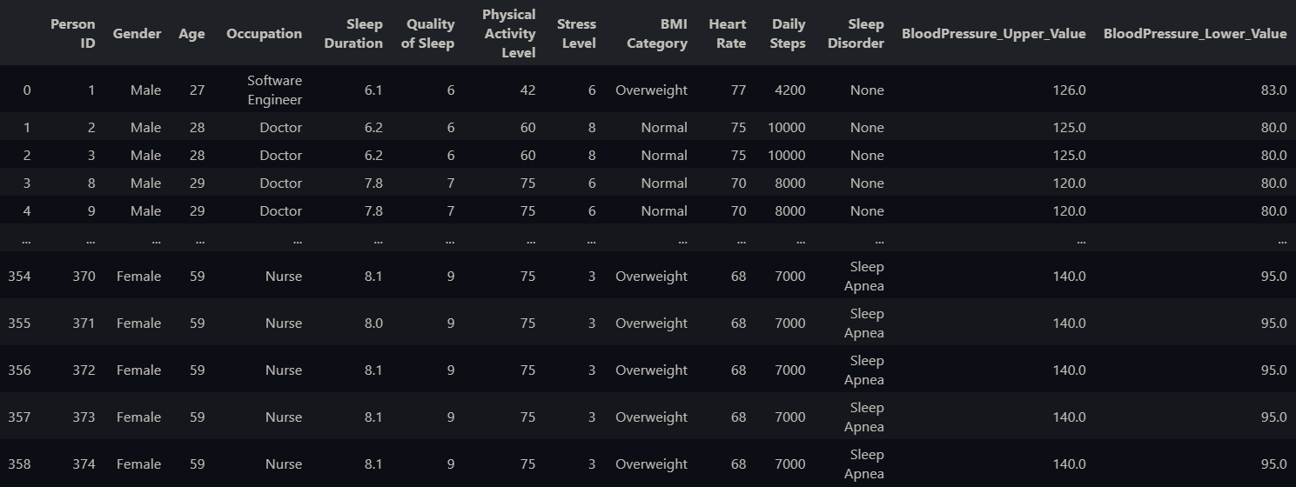
DATASET
The Sleep Health covering a wide range of variables related to sleep and daily habits. It includes details such as gender, age, occupation, sleep duration, quality of sleep, physical activity level, stress levels, BMI category, blood pressure, heart rate, daily steps, and the presence or absence of sleep disorders.
3 / 12

Slide 4
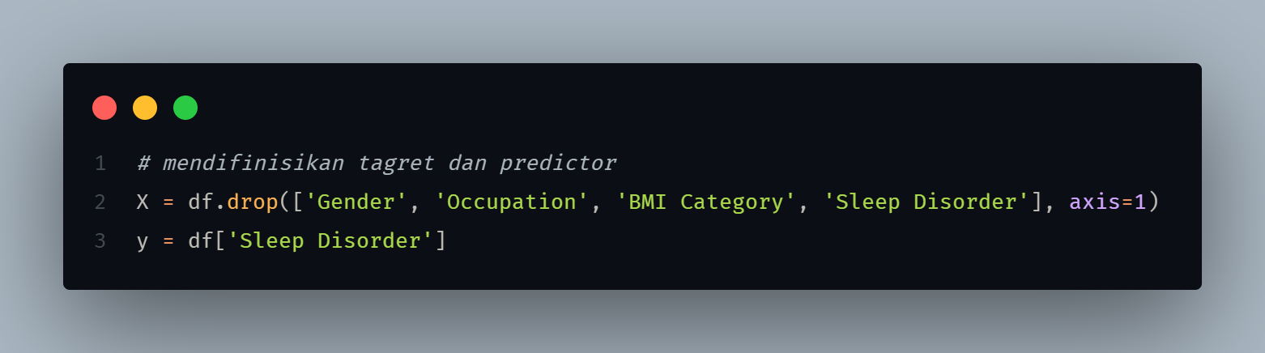
TARGET & PREDICTOR
predictor
target
4 / 12

Slide 5
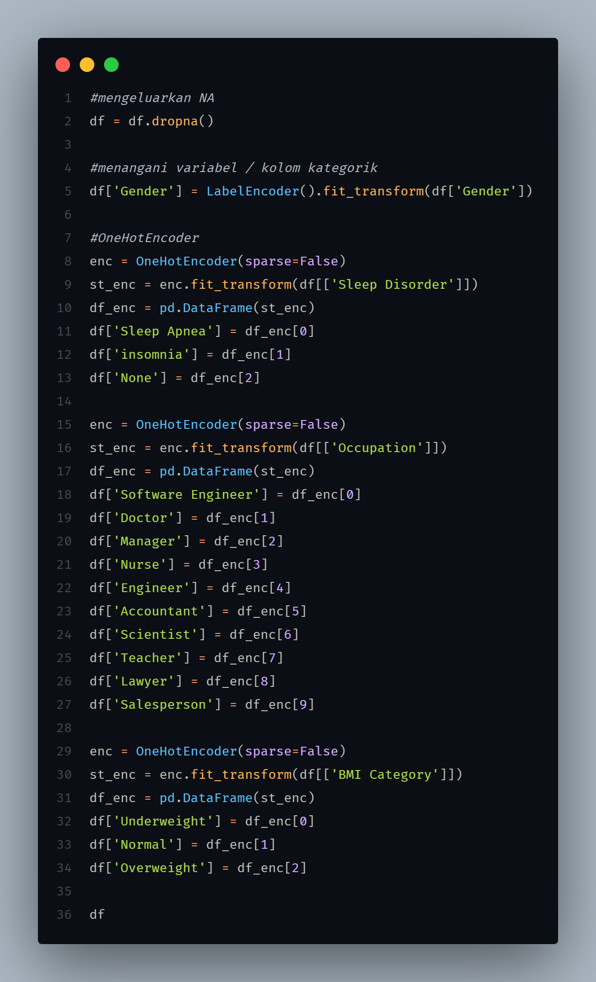
DATA PREPARATION
For preprocessing,
Using LabelEnconder, OneHotEncoder
5 / 12

Slide 6
MODEL
1
KNeighborsClassifier
2
LogisticRegression
3
SVC
6 / 12

Slide 7
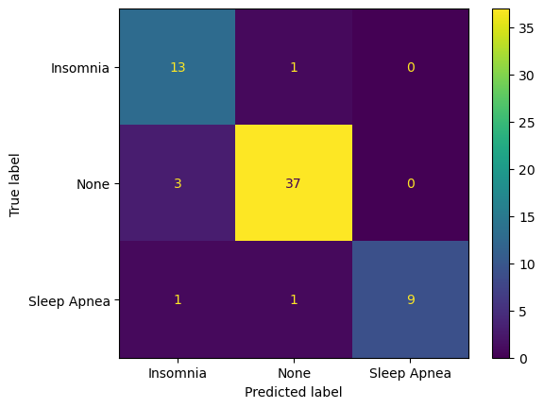
KNeighborsClassifier
EVALUATION | Values
Accuracy | 0,90
Precision | 0,90
Recall | 0,89
7 / 12

Slide 8
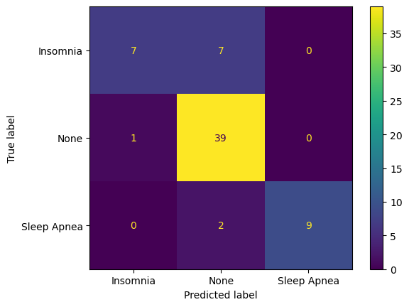
LogisticRegression
EVALUATION | Values
Accuracy | 0,84
Precision | 0,89
Recall | 0,76
8 / 12

Slide 9
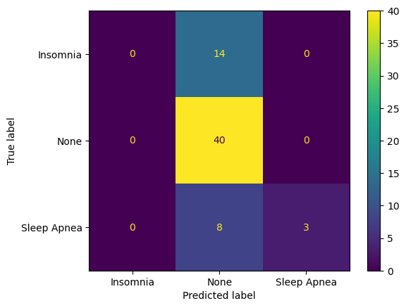
SVC
EVALUATION | Values
Accuracy | 0,66
Precision | 0,54
Recall | 0,42
9 / 12

Slide 10
EVALUATION
MODEL | Accuracy | Precision | Recall
KNeighborsClassifier | 0,90 | 0,90 | 0,89
LogisticRegression | 0,84 | 0,89 | 0,76
SVC | 0,66 | 0,54 | 0,42
10 / 12

Slide 11

EVALUATION
1
KNeighborsClassifier
2
LogisticRegression
3
SVC
11 / 12

Slide 12
THANK YOU

